Slide 1


Slide 2





Autothon 2019
Your Passion for Automation
By Automators Rock Team

Slide 3
Automators Rock Team Details
Mrs.
Renu Singh
Mrs.
Supriya Nandi
Associate Manager, Quality Assuarance
Role: Team Lead and Scrum Master
Email ID: renu.singh@nagarro.com
Lead, Quality Assuarance
Role: Team Lead and Web Automation Expert
Email ID: supriya.nandi@nagarro.com
Mr.
Ashish Garg
Miss
Harshita Shaktawat
Associate Lead, Quality Assuarance
Role: Tech Lead, Web & API Expert
Email ID: ashish.garg@nagarro.com
Senior Associate, Quality Assuarance
Role: Mobile (IOS) Automator
Email ID:harshita.shaktawat@nagarro.com

Slide 4
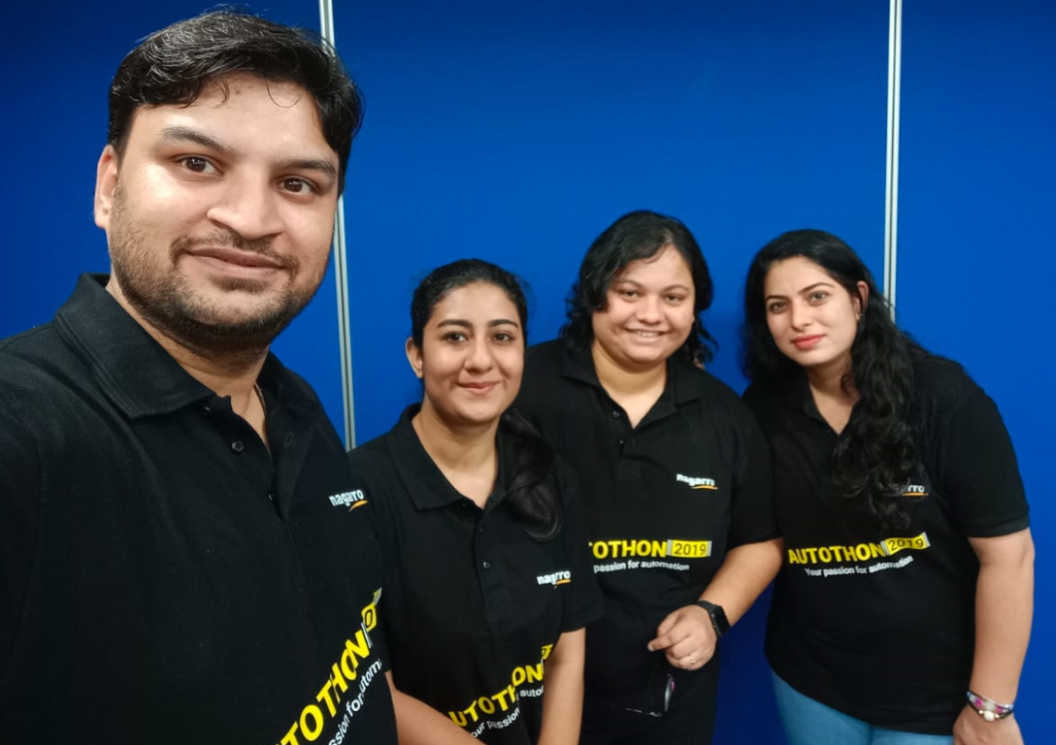
Automators Rock Team Pic

Slide 5

Agenda
1. Types of Testing & Supported Test Platforms
Covers the different types of testing to be covered on the AUT, which can be accessed via Web & Mobile devices.
2. Test Strategy
3. Demo of the Automation Code by the Agile Team.

Slide 6

Software Testing

Slide 7

Words from a QA

Slide 8

Modern QA Expectations

Slide 9

Future QA Responsibilities

Slide 10

Types of Testing Performed
Functional Testing
Regression Testing > Via Automating Scripts (Automation Testing)
Usability Testing
Web & Mobile Supported
API Testing
Performance Testing
Security Testing
Compliance Testing
Testing Plan for 2nd Iteration

Slide 11








Web Support List
Chrome
Internet Explorer (IE)
Mozilla (Firefox)
Sauce Labs
Android
IOS (iPad & iPhone)
Mobile Devices Support List

Slide 12

Test Strategy
Refer the Test Strategy document

Slide 13

Demo Time
Demo by the Agile Team

Slide 14


Slide 15


Test Plan for 2nd Iteration
Implement the Demo Feedback (if any) in the second Iteration (2nd Sprint) for the Agile Project ‘Movie Rental Service’.
Along with this cover the following testing types in the sprints.
Performance Testing
Security Testing
Compliance Testing

Slide 16
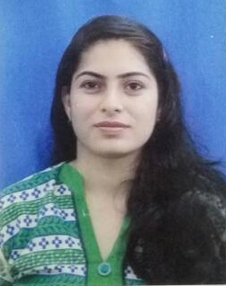



Renu Singh
Associate Manager, Quality Assurance
renu.singh@nagarro.com
https://www.linkedin.com/in/renusingh1/
+91 9582349808

Slide 17





Thank You to All
TIMISOARA Team :
Viennia Team :
Munich Team :
India Team :
From: Automators ROCK Team

Slide 18


Thank You
From Automators ROCK Team .

